Slide 1
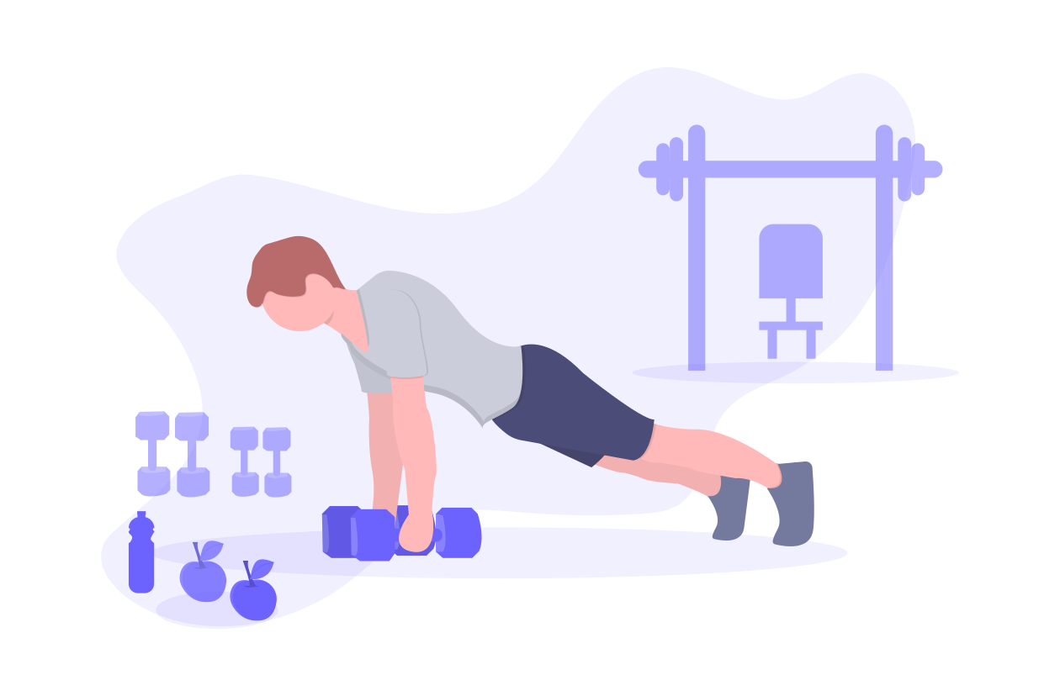
Habit Oasis

Slide 2


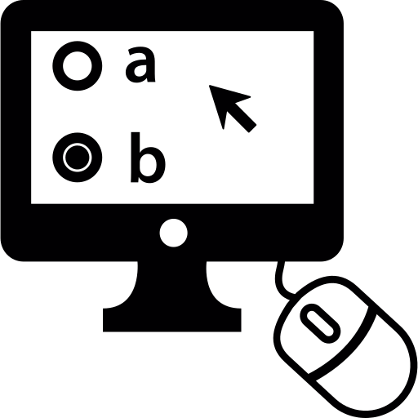
Problems & Solutions
Forgetting to do things
Development of a personalized reminders system
Lack of time/motivation/organizing,
procrastination, comfort, stress
Community, constant reminders
Lack of user-friendly interfaces, responsiveness
or features for motivating friends
Modern app, custom profile, community

Slide 3



Competition & Advantage over competition
Habitica (1M+)
Easier to add new tasks and edit them, reliable notifications and more modern design
Fabulous Daily Routine Planner (10M+)
Easily accessible without a membership paywall
Habit tracker (1M+)
Easy to mark progress and data synchronization using the account

Slide 4





Customer segments & Revenue Streams
Students (15-25)
App subscription
Adults (25-50)
Ads
Seniors (50+)
One time purchase

Slide 5
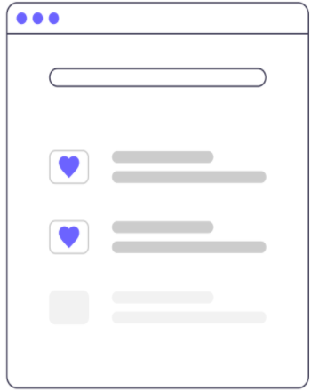
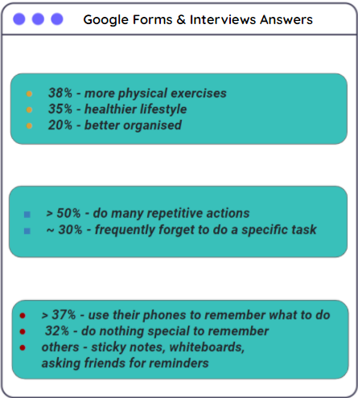
Customer validation
Google Forms & Interview Answers
People like and are motivated by:
38% - more physical exercises
35% - healthier lifestyle
20% - better organised
motivational videos 75%
challenges 95%
timed competitions 77.5%
alarms 87.5%
notes apps for planning 82.5%
strict programs 70%
sharing w/ friends 85%
constant reminders 47.5%
personalizable apps 77.5%
> 50% - do many repetitive actions
~ 30% - frequently forget to do a specific task
> 37% - use their phones to remember what to do
32% - do nothing special to remember
others - sticky notes, whiteboards, asking friends for reminders

Slide 6
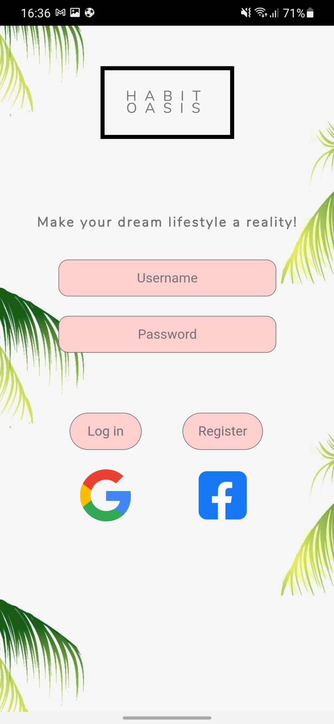
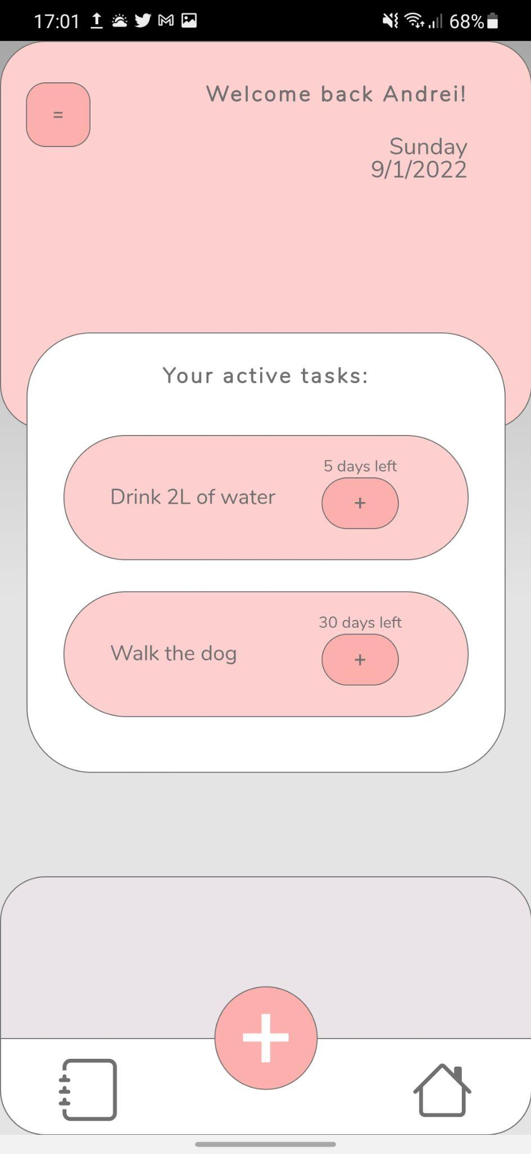
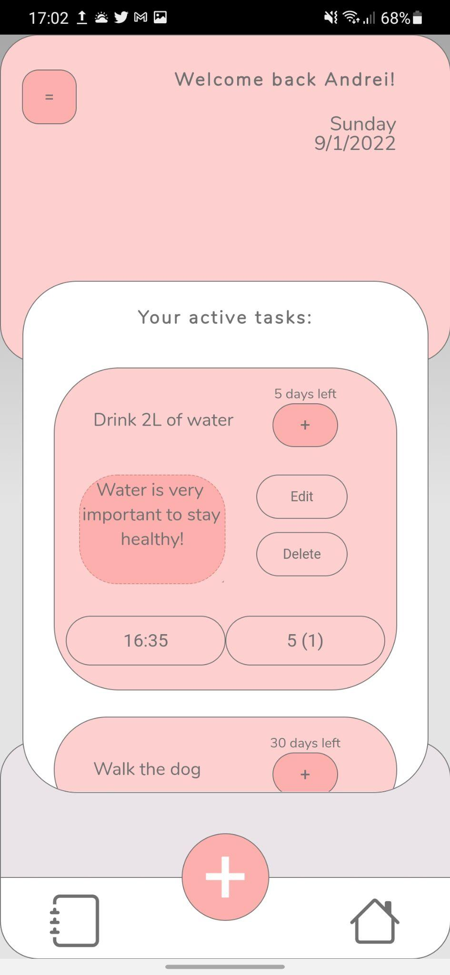
MVP validation

Slide 7
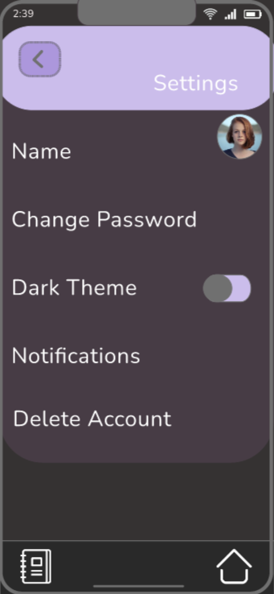
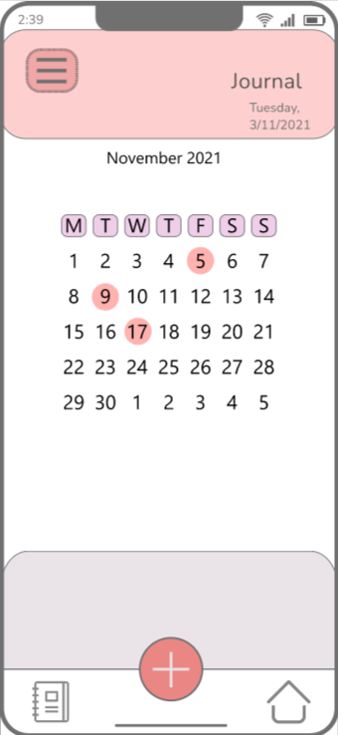
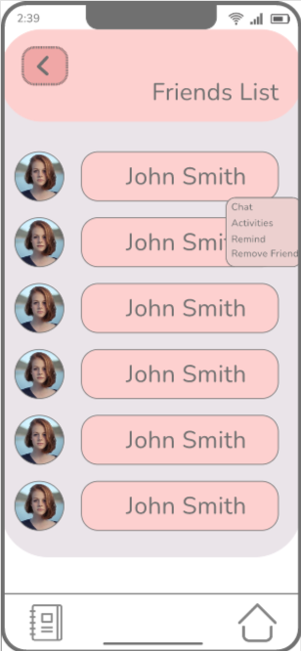
Future App Design Updates
Notes:
https://xd.adobe.com/view/9c25d789-3082-4b57-5c7e-0cfd2ba152c1-ea14/

Slide 8
Users feedback
Positive
Constructive
Sharing with friends and motivating them
Profile customization
Reminders
Subscription price
Tasks examples

Slide 9
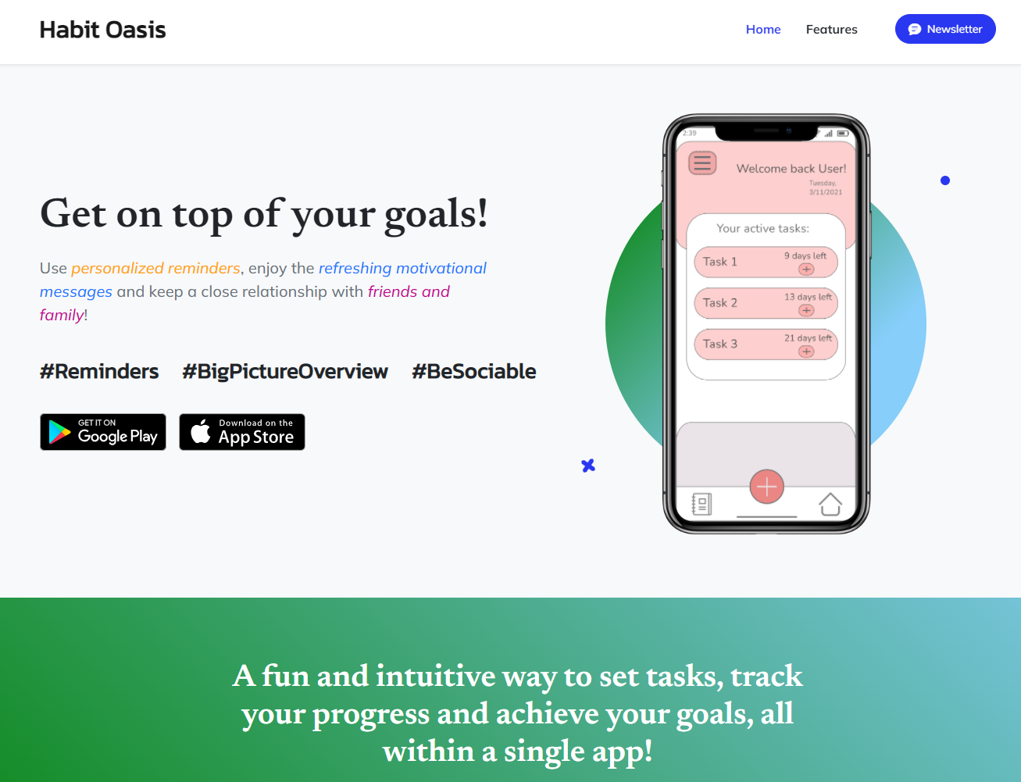
Landing page
126 Page views
58 Scrolls
5 Subscribers

Slide 10
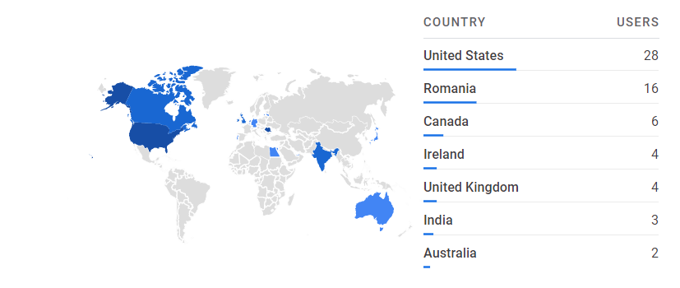
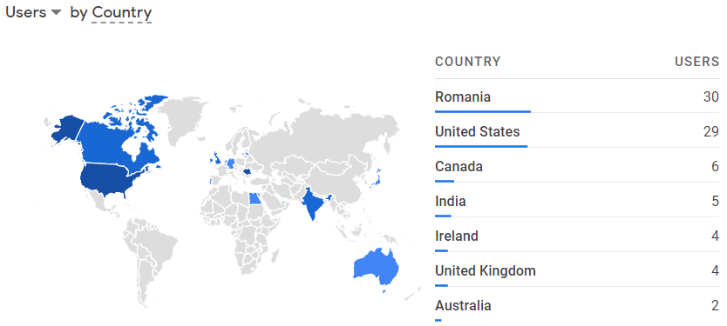
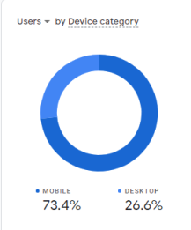
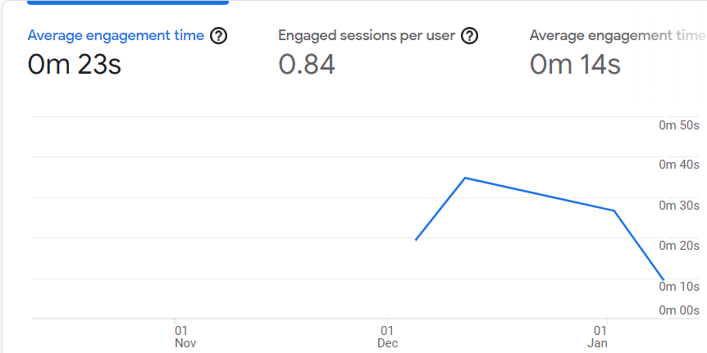
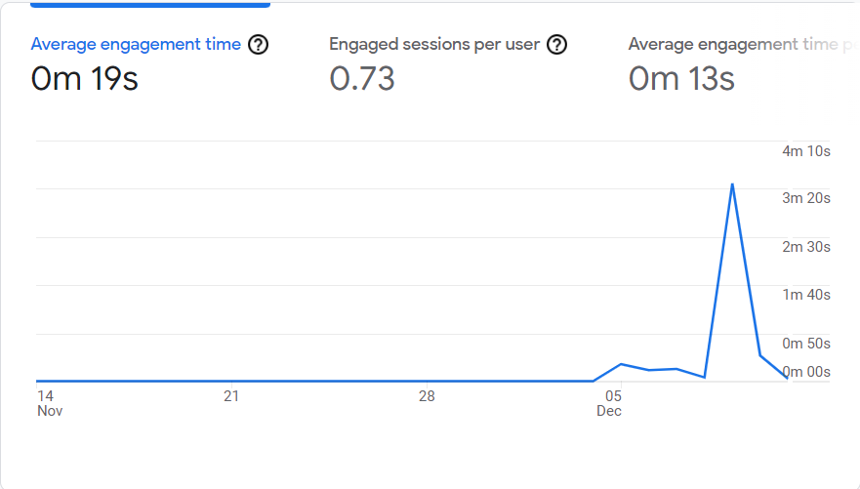
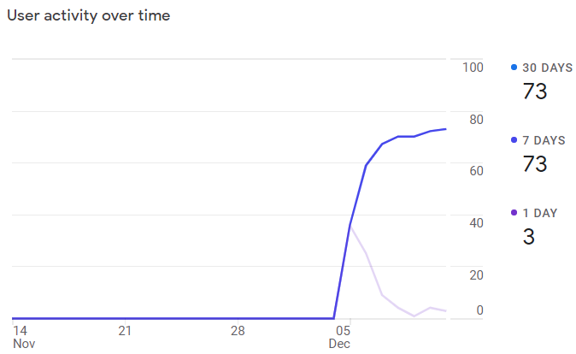
Analytics
Reddit
Instagram
Facebook
Direct
LinkedIn

Slide 11

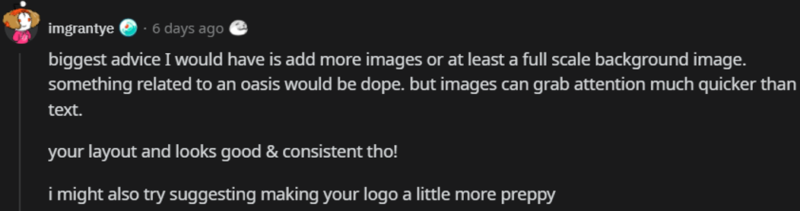
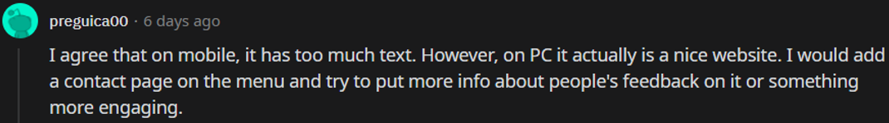
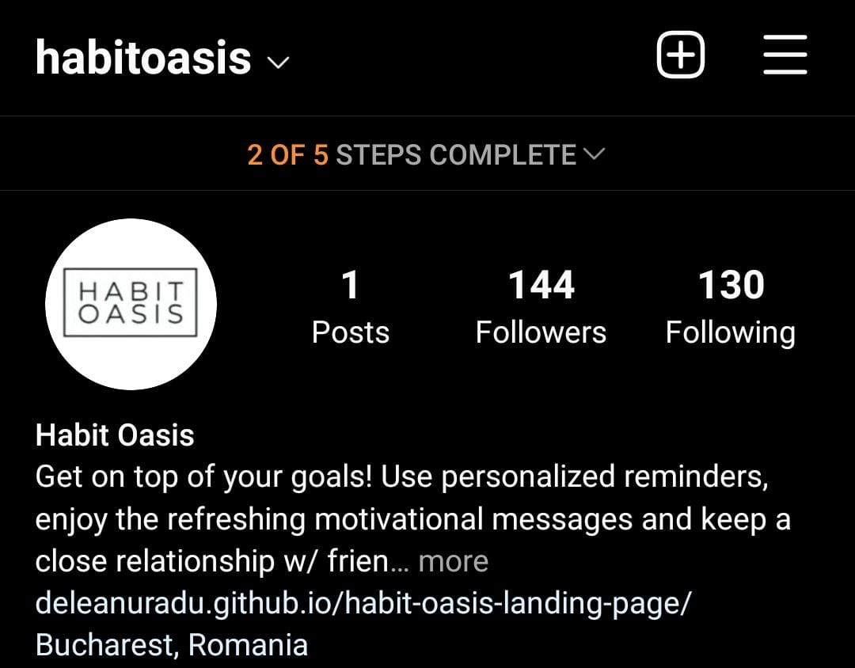
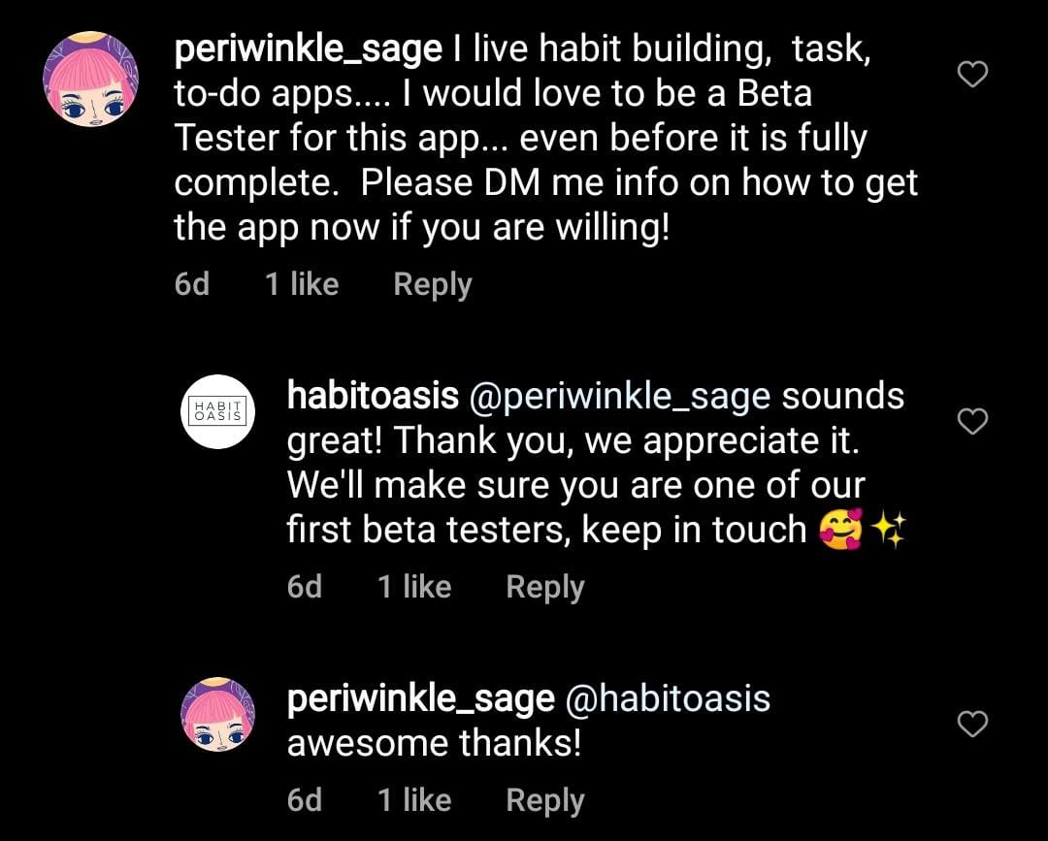
Feedback (app & landing page)

Slide 12
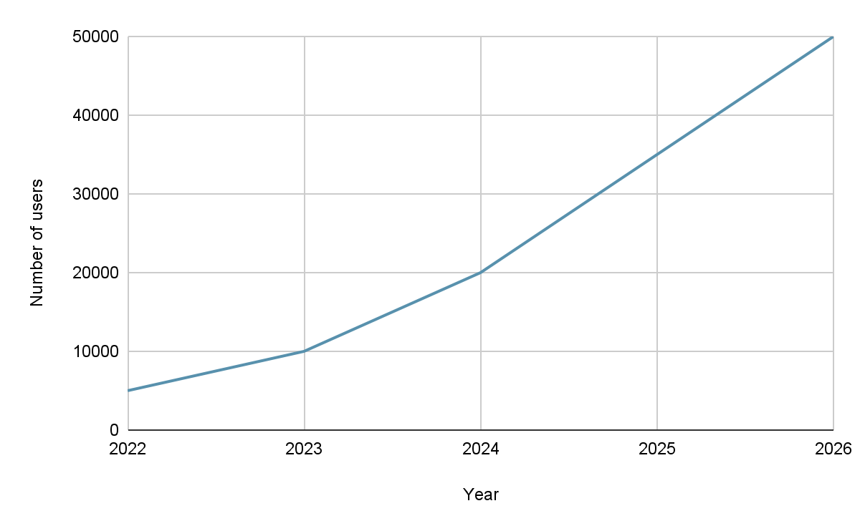
Conclusions
Idea was validated => started building a first version of our app
Approximation of 5K users for the first year
20% Premium Package Users for the first year

Slide 13

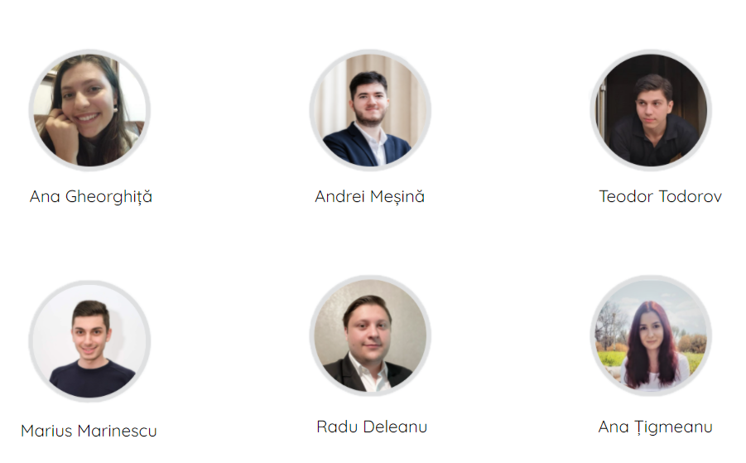
OUR TEAM

Slide 14
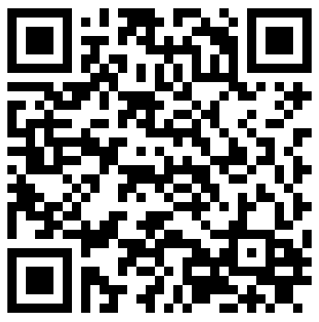


Habit Oasis
Thank you!
Q&A
habitoasis
@habitoasis

Slide 15
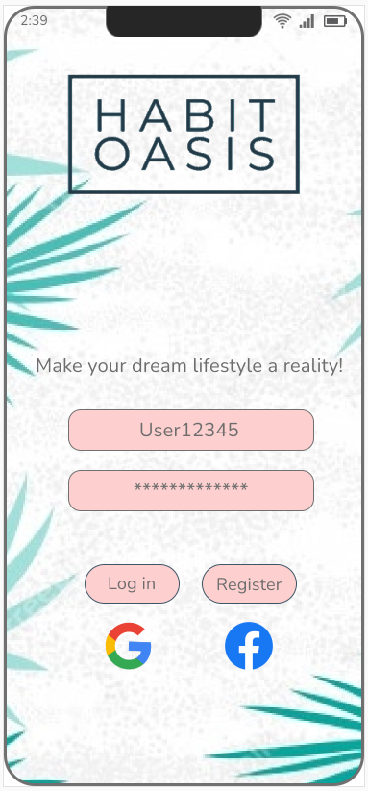
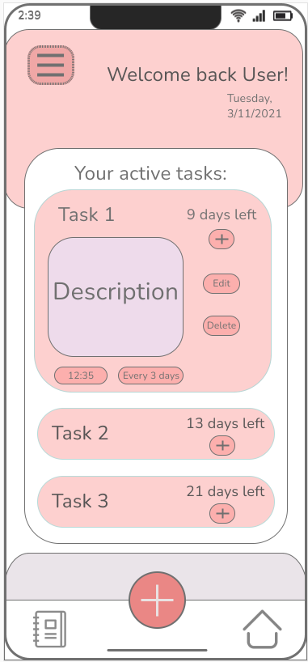
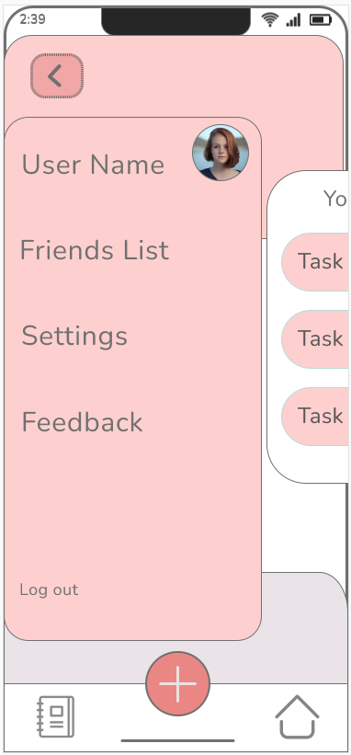
MVP validation (after feedback)

Slide 16
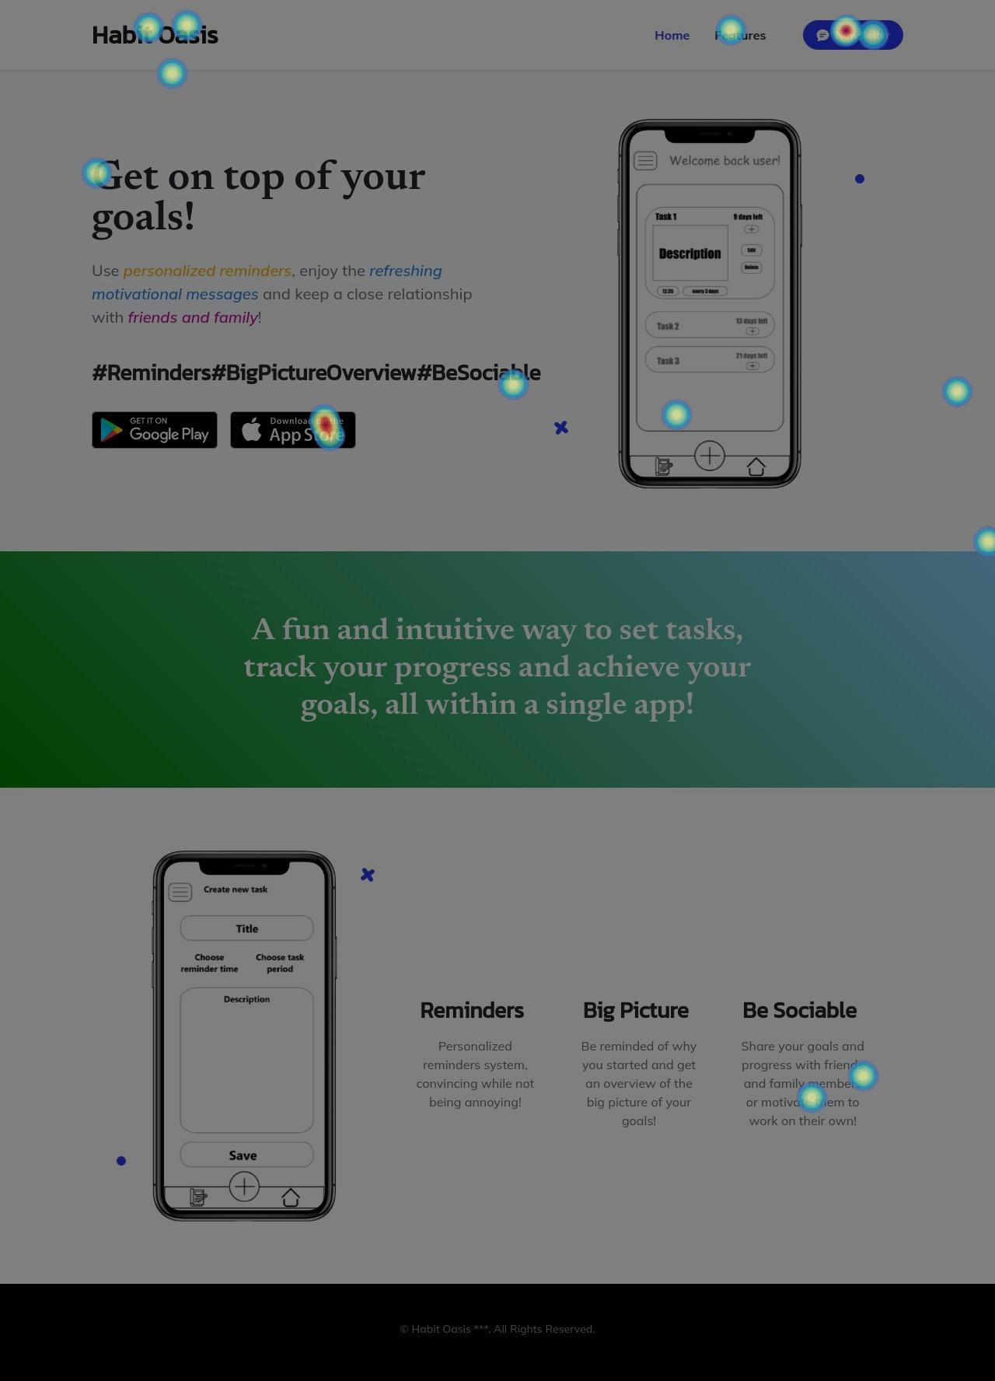
Hotjar Heatmap

Slide 17
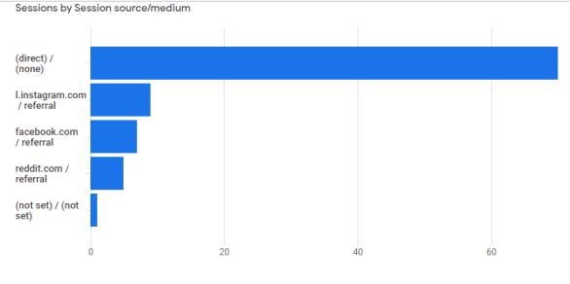
Analytics
Not all the sessions launching platforms were registered correctly (most of them are "direct/none"), but we concluded, based on feedback (comments on posts/direct messages) and other statistics on Hotjar that the posts bringing us the most people were the ones on Reddit, followed by Instagram and Facebook.

